Slide 1


Analysis of Greenhouse Gas Emissions
GROUP 13:
SEJAL BHAN
SHARAN SRINIVASAN
CHRISTIENE CHERIAN
ZHENLING LIU
MANUEL FERNANDES
JIAWEI XU
268374566
441056765
930428291
872529384
329205126
874215514
BUSINFO 701 Group Project

Slide 2




Agenda
Introduction
Data at a Glance​
Questions posed
Limitation of combining the datasets
Implications for decision makers
Notes:
Change the 'Questions'
Audience NZ government and International Climate activist organization who work with the government to reduced

Slide 3


Introduction
Objective:
Conduct a cross-country analysis of greenhouse gas emissions to understand key trends and patterns.
Analysis Overview
Components of greenhouse gas (GHG) emissions
In-depth examination of New Zealand's GHG landscape
Assessment of environmental expenditure in New Zealand
Critical implications for policymakers

Slide 4


Data at a Glance
Datasets used: OECD + World Bank + IMF
Used Python for data sourcing, auditing and wrangling
Visualisations were created on PowerBI and Python
Web-scrapping techniques

Slide 5
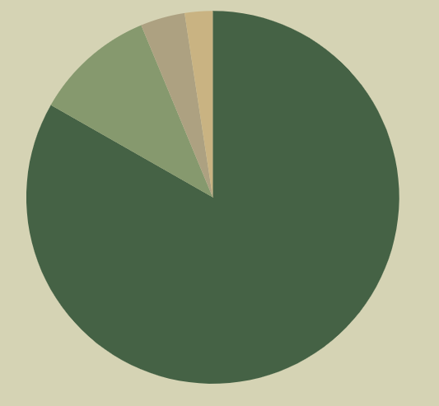
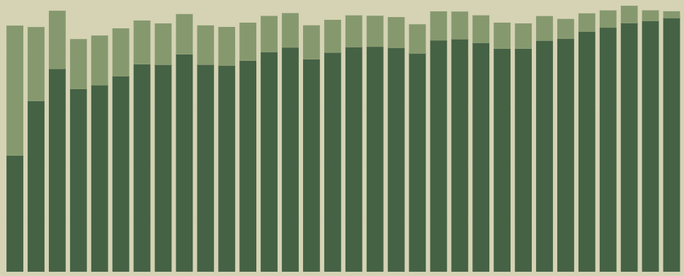
What are the dominant components of Greenhouse Gas emissions, and what are their primary sources across sectors? Does it vary between countries?
Landscape: CO₂ and CH₄ levels
CO₂
CH₄
N₂O
Other gases
3.8%
2.4%
100%
10.4%
80%
60%
Proportion of CO₂ & CH₄
40%
20 %
83.2%
0 %
CO₂ dominates globally
83.2%
Latvia
France
Chile
Ireland
Portugal
Canada
Iceland
Spain
Italy
Japan
Australia
Hungary
Greece
Turkey
Poland
Austria
Estonia
Lithuania
Denmark
Slovakia
Norway
New Zealand
Slovenia
Switzerland
Sweden
Finland
Belgium
Germany
South Korea
United Kingdom
Netherlands
Luxembourg
Notes:
NZ: methane dominates here
Methane is the most toxic element
CO₂: Fossil fuel combustion, deforestation, industrial processes.
CH₄: Agriculture (livestock), waste management (landfills), natural gas leaks.
N₂O: Fertilizer use in agriculture, chemical production.
Fluorinated gases: Refrigerants, industrial applications.

Slide 6

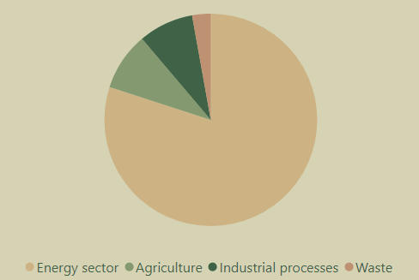
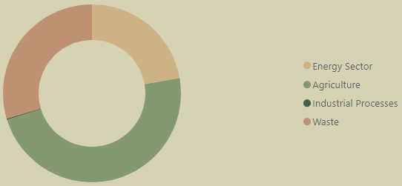
GHG from different sectors
CH₄ from different sectors
2.8%
8.3%
8.8%
22.2%
29.6%
80%
Industrial Processes
Agriculture
0.1%
Energy Sector
Waste
47.9%
80%
Energy Sector
8.3%
Industrial process
Industrial Processes
Agriculture
Energy Sector
Waste
VS
8.8%
Agriculture
Notes:
Sources of Dominant GHG Components:
Carbon Dioxide (CO₂):
Primary Sources: Energy production (burning fossil fuels for electricity and transportation), industrial processes (cement and steel manufacturing), and deforestation.
Global Contribution: CO₂ emissions are the largest share of total GHGs due to the pervasive use of fossil fuels in modern economies.
Methane (CH₄):
Primary Sources: Agriculture (enteric fermentation in livestock), waste management (landfills), and fossil fuel extraction (natural gas leaks).
Global Contribution: Methane has a higher warming potential per molecule than CO₂, making it a critical focus for emission reduction strategies.
Nitrous Oxide (N₂O):
Primary Sources: Fertilizer use in agriculture and chemical production processes.
Global Contribution: Although less abundant, N₂O is a potent greenhouse gas.
Other GHGs (Fluorinated Gases):
Primary Sources: Industrial applications (refrigerants, solvents).
Global Contribution: Small but highly impactful due to their extreme warming potential.

Slide 7

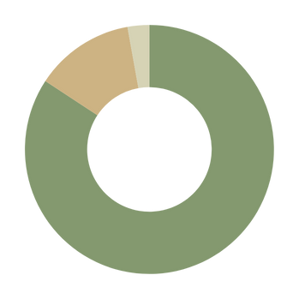
What is the current state of methane emissions in New Zealand?
394, 000
1.5%
Kilotons of CO₂ equivalent
8.6%
CH₄
CO₂
47.5%
of total GHG
N₂O
Other gases
VS
10.5%
of total GHG
(average for all countries）
Industry Methane Emissions Contributes
42.4%
47.5%
The agriculture sector contributes the most to methane emissions – livestock farming.
Methane from waste – landfills and waste decomposition.
Fugitive emissions and others – leaks or releases of gases from industrial processes or natural resource extraction.
83.4%
12.8%
2.8%
83.4% (Agriculture)

Slide 8

What is the trend of environmental expenditure in NZ and has it been effective in controlling emissions?
1.0 %
84,000
0.8 %
83,500
0.6 %
Environmental expenditure (Percent of GDP)
83,000
Expenditure(Percentage of GDP)
Total GHG Emissions (in tonnes)
Total GHG Emissions
0.4 %
82,500
0.2 %
82,000
0.0 %
81,500
2011
2012
2013
2014
2015
2016
2017
2018
2019
2020
2021
YEAR
Decline in expenditure
Expenditure level at 0.9%
Peak emission levels
Sharp dip in emissions
2014 - 2017
Post 2017
2019
2020

Slide 9

The dataset does not include information on policies implemented by New Zealand to address GHG emissions.
It lacks insights into the effectiveness of these policies in reducing emissions.
Limitation
5
5
What policies have been implemented to address greenhouse gas emissions, and how effective have they been?
3
Number of Policies
2
1
1
1
2011
2012
2013
2016
2019
2020
2021
YEAR

Slide 10

Key Implications for New Zealand’s Policymakers
Methane Reduction as a key focus
Agriculture as a Major Contributor
Optimising Investments
47% of NZ emissions
Highly toxic and potent
Short atmospheric lifespan (~10 years)
Tackling methane is a powerful lever in reducing emissions
83.4% methane emissions
Low-methane livestock breeds maintain productivity while cutting emissions
Supporting farmers with incentives and technologies is key
Consistent spending and policies reduced emissions
Current policies fall short: 2030 methane targets unmet.
Targeted investment and stronger policies - agriculture and waste

Slide 11

Questions?

Slide 12
References
New Zealand's target to achieve net-zero Greenhouse Gas Emissions by 2050:
New Zealand Legislation. (2019, November 14).
Retrieved from Climate Change Response Act 2002: https://www.legislation.govt.nz/act/public/2002/0040/latest/LMS282014.html
New Zealand reducing methane emissions from farming:
Rykers, E. (2023, December 16). BBC.
Retrieved from New Zealand is reducing methane emissions from farming: https://www.bbc.com/future/article/20231214-how-new-zealand-is-reducing-methane-emissions-from- farming?trk=public_post_comment-text
Electric vehicle policy in the New Zealand:
Williams, B. (2023, December). Impacts of electric vehicle policy on the New Zealand energy system: A retro- analysis. Retrieved from Science Direct:
https://www.sciencedirect.com/science/article/pii/S2352484723002251

Slide 13
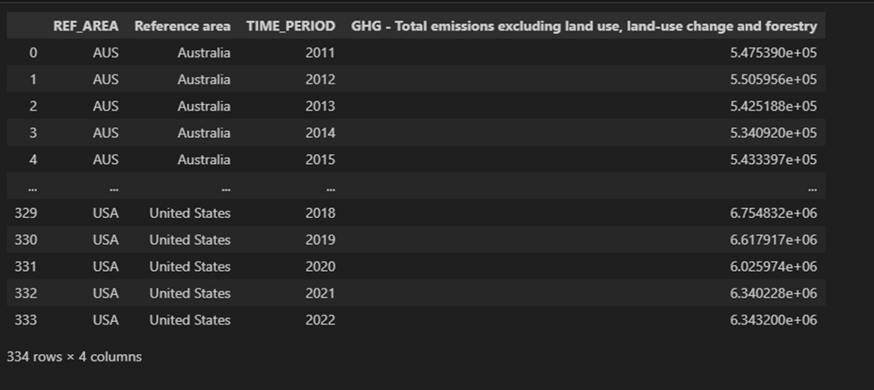
Appendix 1.1
Cleaned Original Dataset Prior to Merging

Slide 14
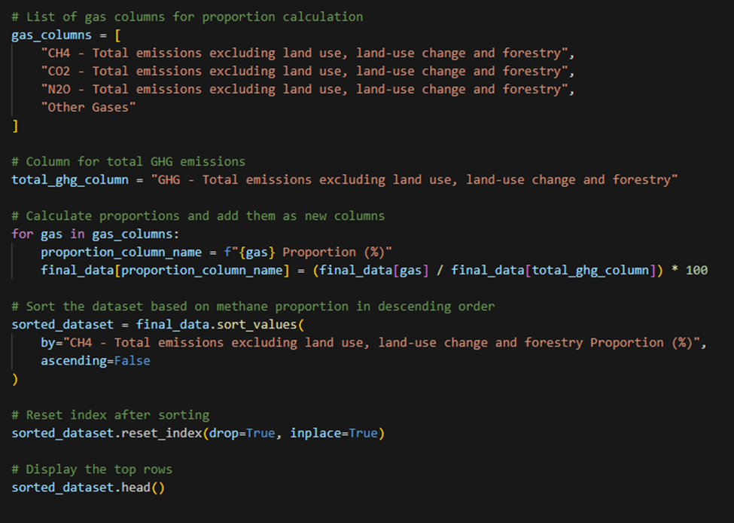
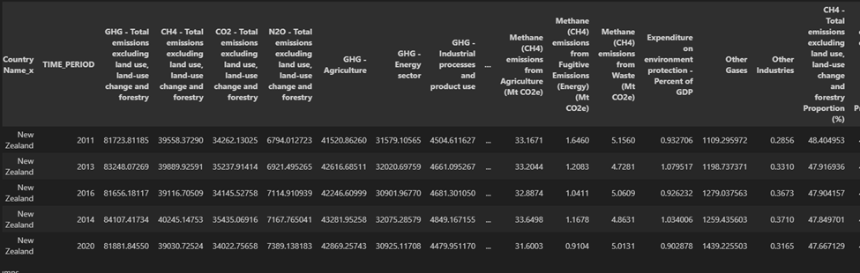
Appendix 1.2
Question 1 : Components of Greenhouse Gases and its Sources across Countries

Slide 15
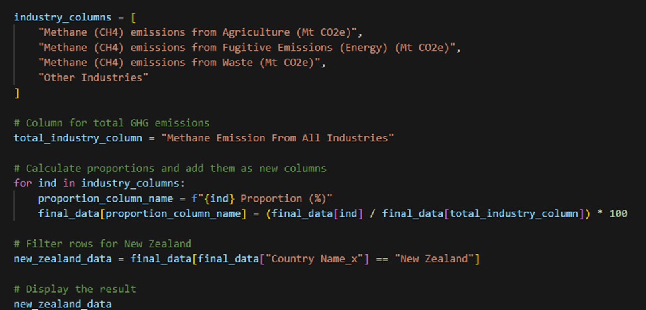
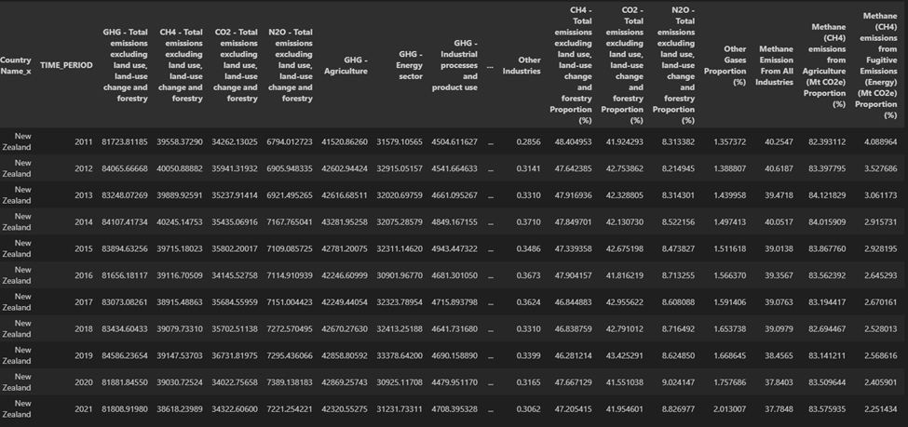
Appendix 1.3
Question 2: Current State of Methane Emissions in NZ

Slide 16
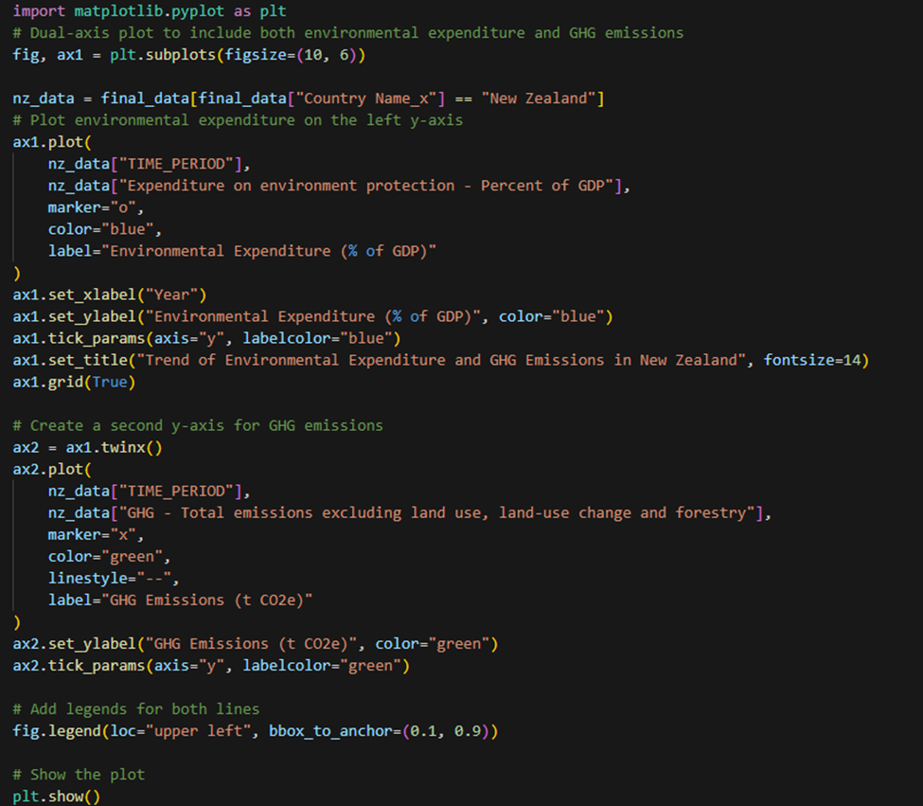
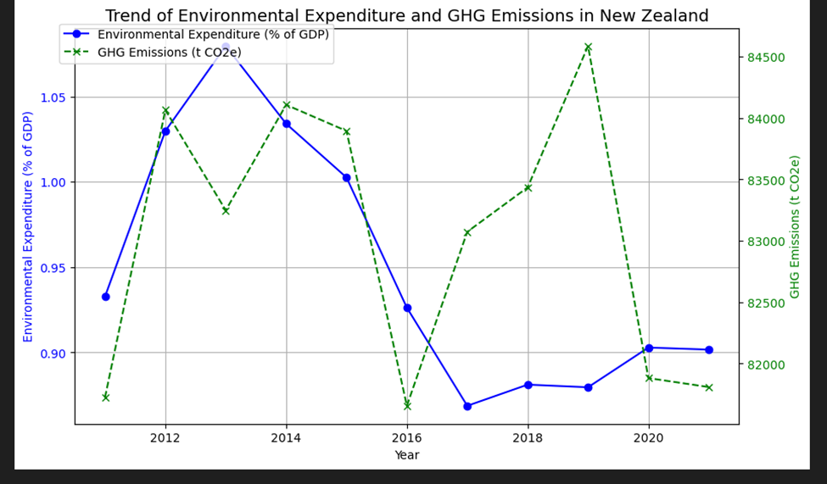
Appendix 1.4
Question 3: Trend of Environmental Expenditure in NZ and its effectiveness

Slide 17
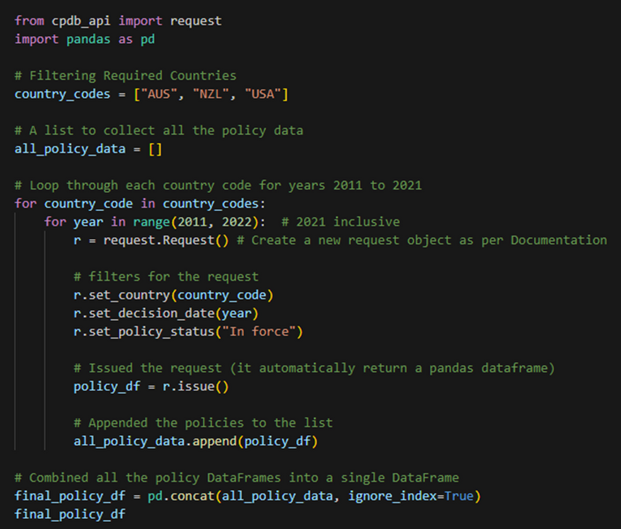
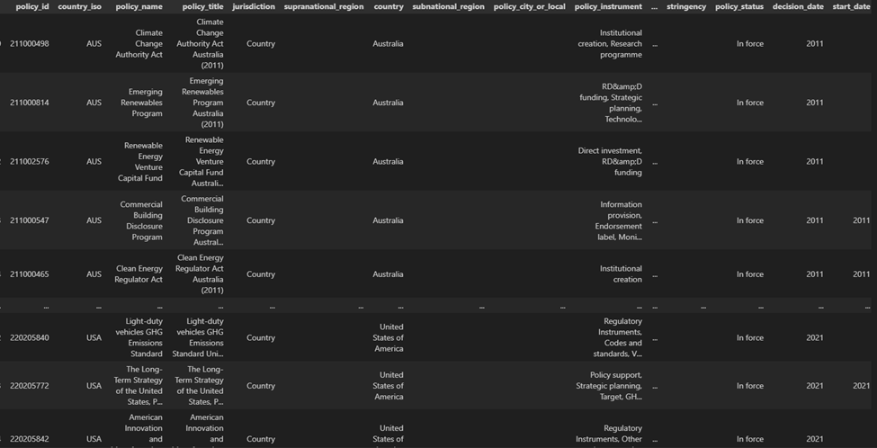
Appendix 1.5
Web Scraping

